Slide 1







Research Defense
VOICE OF AUTOMATIC TRANSLATION WORK
VERSUS TRANSCREATION WORK
BY: SILVIA QATRINNADA/2110231007
Dosen Pembimbing: Kristi Nuraini M.Pd
PUBLISHED IN JOURNAL LA SOCIALE
Universitas 17 Agustus 1945 Samarinda

Slide 2

Background of the Research
The need for a creative approach to preserve cultural nuances and target readers’ context. Transcreation helps adapt content to be more culturally and emotionally relevant.
Elnesil, 2023 mention that Automatic translation tools are popular but they have lack of limitations, they cannot fully replace human involvement in
Translation is essential for communication across cultures.

Slide 3


Significance of the Research
Problem of the Research
How can transcreation improve the quality of translations and make them more culturally and emotionally suitable?
Helps translators, businesses, and academics understand the role of transcreation.
Shows how cultural adaptation improves translation quality.
Objective of the Research
Scope of the Research
Compare automatic translation work and transcreation work to show how transcreation can create translations that are more connected to the target audience.
The study is confined to a comparative analysis of automatic translation and transcreation applied to a specific case: translating the Google Accelerator Playbook from English to Indonesian. It evaluates the application of eight translation procedures proposed by Newmark (1988).

Slide 4
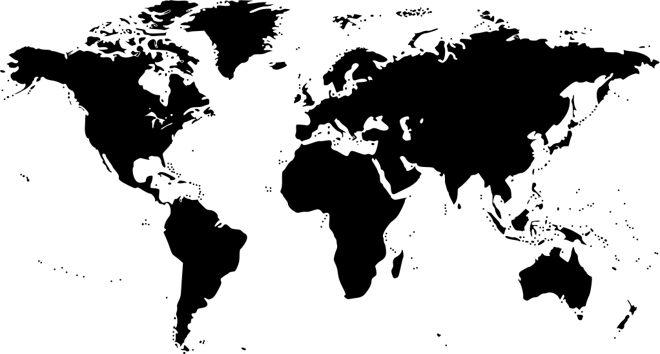

Literature Review
Translation
(Wulandari, 2022) mention that translation is the process of meaning transferring from source language to target language in order to make more understanding. According to Newmark (1988), translation involves various procedures to address linguistic and cultural gaps, ensuring the target audience’s understanding and engagement.
Translation Tools
(Sdobnikov, 2018) translation Memory (TM) systems and machine translation called CAT or Computer -Assisted Translation. CAT tools can help improve the accuracy and efficiency of translations
Transcreation
Transcreation is an effective and flexible for communication writing, requiring multi-party interplay and producing new constructs, offering both challenges and opportunities for translators (Wang et al., 2021).

Slide 5


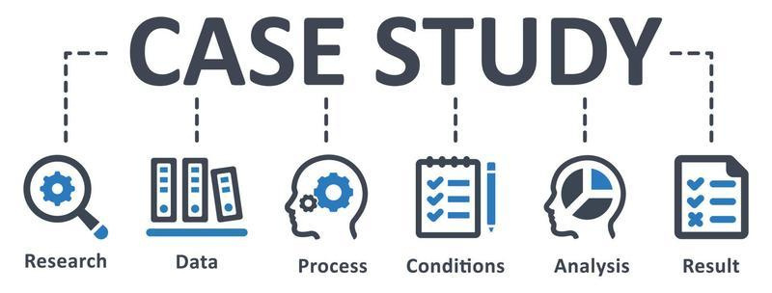

Data Source
The research analyzes translations done by student interns at a translation company in Jember.
RESEARCH METHODOLOGY
Subject and Area
Descriptive Qualitative Research
Translating Google Accelerator Playbook and comparing outputs from automatic translation tools (SDL Trados) and human transcreation based on Newmark's (1988) translation procedures.
Evaluation Criteria
Translations are assessed for accuracy, cultural relevance, and emotional impact.

Slide 6



THE RESULT OF THE RESEARCH
Correlation Between Automatic Translation and Transcreation
  Automatic translation ensure efficiency, while transcreation adapts meaning and style.
Comparison of Methode
  Eight translation procedures (Newmark) focus on linguistic accuracy
  While transcreation enhances emotional and cultural adaptation
Strengths and Weaknesses
  Automatic translation is fast and consisten but lack of cultural nuance
  While transcreation engaging cultural adapted but time-consuming
Best use Cases
  Automatic translation is ideal for technical text
  Transcreation is better for marketing, advertising, and persuasive content.

Slide 7


Research Findings
Aspect | Findings
Translation procedures | Identified eight methods
Automatic translation using CAT Tools | Fast, consistent, and efficient
Transcreation process | Work as emotional connection and adaptation
Comparison CAT and Transcreation based on (Newmark) translation procedures | Combining CAT tools and transcreation improve accuracy, cultural relevance and effective communication

Slide 8
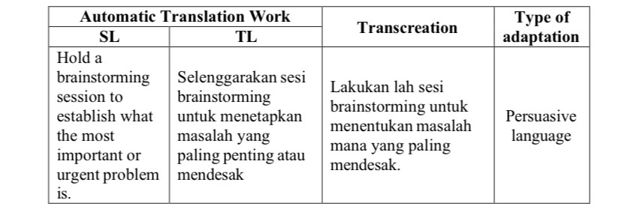
Research Findings
Tabel 9. Transference

Slide 9
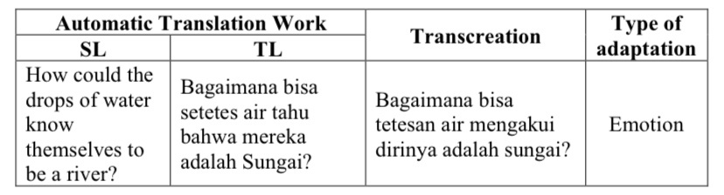
Research Findings
Tabel 7. Modulation

Slide 10
Discussion
The discussion highlights the advantage and disavantage of both methods:
  Automatic Translation Work
  Advantage: Efficiency, consistency, and cost-effectiveness.
  Disavantage: Limited contextual understanding, lack of cultural sensitivity, and inability to convey emotional nuances.
2. Transcreation Work
  Advantage: It produces translations that feel natural and connect emotionally with the audience.
  Disavantage: It is more time-consuming and requires more effort.

Slide 11

CONCLUSION
Translation work using CAT tools aid effeciency but still require human intervention to ensure accuracy and cultural relevance.
Transcreation work is a more relevant approach for persuasive text that can be more understanding for target readers.
Combining the automatic translation tools with the creativity of transcreation gives the best results for better understanding target language.

Slide 12





