Slide 1
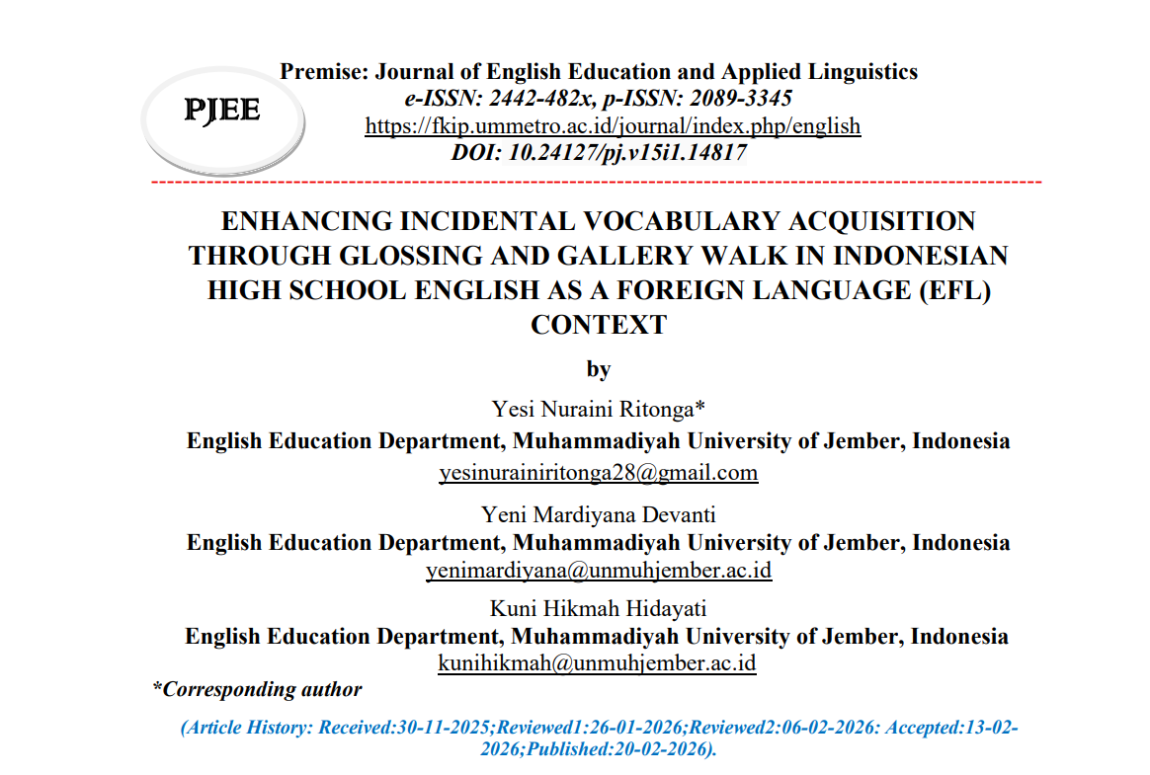
2026
Universitas Muhammadiyah Jember
ENHANCING INCIDENTAL VOCABULARY ACQUISITION THROUGH GLOSSING AND GALLERY WALK IN INDONESIAN HIGH SCHOOL ENGLISH AS A FOREIGN LANGUAGE (EFL) CONTEXT
Dr. Indah Werdiningsih, M.Pd
Dosen Penguji
Dr. Indri Astutik, M.Pd
Dosen Pembimbing 1
Yeni Mardiyana Devanti, M.Pd
Dosen Pembimbing 2
Yesi Nuraini Ritonga
NIM: 2210231013
Pendidikan Bahasa Inggris
01

Slide 2
2026
Universitas Muhammadiyah Jember
Background of the Research
Low vocabulary mastery in EFL students
07
Vocabulary learning often relies on memorization
08
Need for meaningful vocabulary learning
09
Glossing + Gallery Walk as a solution
10
02

Slide 3
2026
Borcelle University
Research Problem
Research Objective
How is glossing strategy supported by Gallery Walk implemented to enhance students’ incidental vocabulary acquisition?
To examine how the implementation of glossing and Gallery Walk improves students’ incidental vocabulary acquisition.
Novelty
GAP
This study integrates glossing with Gallery Walk as an interctive learning activity
Previous studies mainly examined glossing as a stand-alone reading strategy
03

Slide 4
2026
Universitas Muhammadiyah Jember
Literature Review
Incidental Vocabulary Learning
Glossing Strategy
  Students acquire new words through meaningful exposure without direct memorization (Liu, 2015).
  Glossing helps learners notice and understand unfamiliar vocabulary during reading (Yanagisawa, 2020).
Gallery Walk
Involvement Load Hypothesis Plus (ILH+)
  Gallery Walk provides an interactive learning environment through movement and task-based activities (Bahtiar et al., 2020).
  Learning is more effective when students actively process and engage with vocabulary (Yanagisawa & Webb, 2022).
04

Slide 5
2026
Universitas Muhammadiyah Jember
Research Methods
Research Design
Participants
Instruments
  CAR (Classroom Action Research)
  Kemmis & McTaggart model
  Conducted in two cycles
  10 eleventh-grade students
  SMA Muhammadiyah 1 Rambipuji
  Vocabulary test (pre-test & post-test)
  Observation checklist
Research Analysis
  Quantitative: mean score & percentage
  Qualitative: students’ engagement and participation
05

Slide 6
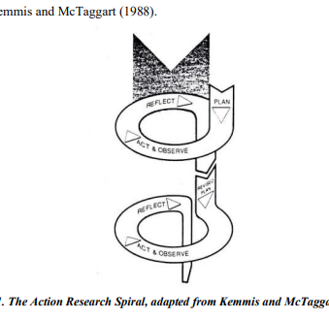
2026
Universitas Muhammadiyah Jember
Research Process
Planning
Acting
Observing
Reflecting
  Preparing glossed reading texts, designing Gallery Walk activities, vocabulary tests, and observation checklists.
  Implementing glossing and Gallery Walk through two cycles: Cycle I and Cycle II with improved materials and instructions.
  Observing students’ participation, engagement, and vocabulary understanding during the learning process.
  Evaluating the test results and observations; improvements were made in Cycle II until students showed better engagement and vocabulary understanding.
06

Slide 7
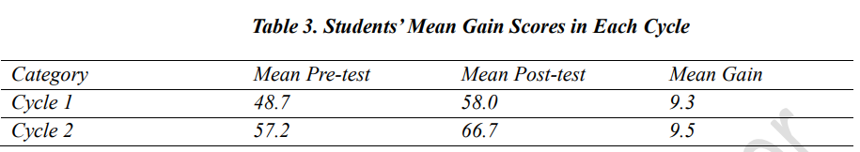
2026
Universitas Muhammadiyah Jember
Result
Vocabulary Test Result
Minimum Mastery Criterion (MMC) = 65
07

Slide 8
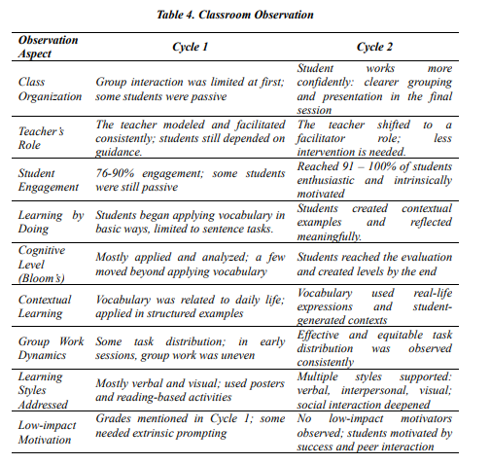
2026
Universitas Muhammadiyah Jember
Observation Result
07

Slide 9
2026
Universitas Muhammadiyah Jember
Discussion
Glossing and Gallery Walk improve students’ vocabulary learning
Students become more active and engaged during the learning process
Learning through context and interaction supports better vocabulary retention
08

Slide 10

2026
Universitas Muhammadiyah Jember
Conclusion
Glossing and Gallery Walk help improve students’ vocabulary learning by making them more active and engaged in the learning process
09

Slide 11
2026
Universitas Muhammadiyah Jember
Recomendation
Teachers are encouraged to use glossing and Gallery Walk in vocabulary learning
Use larger samples and longer duration in future studies
10

Slide 12
2026
Borcelle University
Thank you
11

